Slide 1


COMP 3074 Mobile App Development I
Week 10

Slide 2
Goals for this week
Designing layout in React Native,
Layout Props.
Layout with Flexbox
Basic navigation
More about styles
Notes:
This week we will be practicing React-native building layouts and components
First, we will introduce navigation as it is rare to have single screen app.
Then, we will design screens using different layouts and components.
Our main goal will be building responsive screens.
We will use videos from chapter 4 (Building Data-Driven App) of this course from linkedIn https://www.linkedin.com/learning/react-native-essential-training/introduction-and-preview?u=2155426

Slide 3

Review

Slide 4
Fetching data - reminder
const getMoviesFromApi = () => {
return
fetch('https://api.dev/end.json’)
.then((response) => response.json())
.then((json) => { return json.data; })
.catch((error) => {
console.error(error);
});
};
The Fetch API provides an interface for fetching resources (including across the network). It will seem familiar to anyone who has used XMLHttpRequest, but the new API provides a more powerful and flexible feature set.
Notes:
Fetch function accepts an address of the endpoint and object with parameters. The default method used by fetch is GET, but you can change to other methods using this object, you can also set required headers and body (if using POST)
Returned response can be converted to json (in most cases that would be the format of the response of the RESTfull service, and then processed by our app father.
You have to handle errors as well (catch) as accessing things outside of the device is unreliable

Slide 5
Asynchronous call
Accessing the web service is done in async way. It means that you have to wait for the result.
Waiting is done through await keyword added to the request.
Automatically, you have to tell anyone using the function that it is async by adding the keyword async to the declaration.
const getMoviesFromApi = async () => {
return
await fetch('https://api.dev/end.json’)
.then((response) => response.json())
.then((json) => { return json.data; })
.catch((error) => {
console.error(error);
});
};
Notes:
Note: the structure of the response will differ from api to api. What we access here by getting json.data, may be different for your specific API
Following the app from the video, you will be getting deals, for other services this root element may be called differently. Also internal structure of each child element of the response will be different.
Do not follow the instructions blindly is you decide to use different API in the future.

Slide 6
FlatList – presenting the data
To present the data fetched we will use FlatList. It is a scrollable component allowing us to present homogeneous list of items
This component requires two parameters:
Array with data
Function that renders each element
<FlatList
data={data}
keyExtractor={
({ id }, index) => id}
renderItem={({ item }) => (
<Text>
{item.title},
{item.releaseYear}
</Text>
)
}
/>
Notes:
Note, homogeneous in this context means that all items are of the same type
Because we have a function rendering each item, we can also style all of them in the uniform way.
The FlatList is very flexible component. It can display Text items, but also many other components such as images.
Another thing that we can do, is making each element interactive, e.g. allowing the user to select item and see the details.
Example: https://snack.expo.io/@ppawluk/week6-1

Slide 7

Basic navigation

Slide 8
Navigation
Basic approach can be done through component state and is based on if statements
It can be used for simple apps with limited number of screens (2-3). Anything more would lead to very unreadable code
Manual implementation of Back button is required
More complex apps should use library react-navigation documented here https://reactnative.dev/docs/navigation
This approach is more complex but allows for two things:
Handling multiple screens
Usage of native navigation elements
Notes:
https://snack.expo.io/@ppawluk/week6-2 shows Basic navigation with Back button
Notice, that this approach is really single page application that selectively shows different layouts depending on the state of the application.

Slide 9
React Navigation - library
The community solution to navigation is a standalone library that allows developers to set up the screens of an app with a few lines of code.
You have to install it in your project using npm (or expo)
Instructions: https://reactnative.dev/docs/navigation

Slide 10
React Navigation – required imports
import 'react-native-gesture-handler’;
import * as React from 'react’;
import { NavigationContainer } from '@react-navigation/native’;
import { createStackNavigator} from '@react-navigation/stack';
Notes:
Note: To finalize installation of react-native-gesture-handler, add the following at the top (make sure it's at the top and there's nothing else before it)

Slide 11
React Navigation – code
You need to wrap the whole app in NavigationContainer.
Usually you'd do this in your entry file, in our case App.js
import 'react-native-gesture-handler’;
import * as React from 'react’;
import { NavigationContainer } from '@react-navigation/native’;
import { createStackNavigator} from '@react-navigation/stack';
const App = () => {
const Stack = createStackNavigator();
return (
<NavigationContainer> {
/* Rest of your app code */}
</NavigationContainer> );
};
export default App;
Notes:
Note: To finalize installation of react-native-gesture-handler, add the following at the top (make sure it's at the top and there's nothing else before it)
Note to Bri: examples in this chapter cannot be hosted on expo.io because there are dependencies that I cannot install. Please add them as a code snippets
The two lines highlighted in yellow are not present in the documentation snippets but without them the code does not work!

Slide 12
React Navigation – code
Next step is to define screens accessible in your application using <Stack.Screen> and link them with components that will implement them.
<NavigationContainer>
<Stack.Navigator>
<Stack.Screen name="Home"
component={HomeScreen}
options={{ title: 'Welcome' }}
/>
<Stack.Screen name="Profile”
component={ProfileScreen} />
</Stack.Navigator> </NavigationContainer>
Notes:
In this example, there are 2 screens (Home and Profile) defined using the Stack.Screen component. Similarly, you can define as many screens as you like. This separation of the navigation logic from each screen implementation makes it easier to use in the apps with more complex navigation structure.
You can set options such as the screen title for each screen in the options prop of Stack.Screen.
Each screen takes a component prop that is a React component. Those components receive a prop called navigation which has various methods to link to other screens.
You can use navigation.navigate to trigger transition between screens.
What is important, is the fact that views in the Stack.Navigator use native navigation mechanisms and animated library giving better UX.
Another benefit is that React Navigation also has packages for different kind of navigators such as tabs and drawer. You can use them to implement various patterns in your app.

Slide 13
React Navigation – code
Next step is to define screens accessible in your application using <Stack.Screen> and link them with components that will implement them.
const HomeScreen = ({ navigation }) => {
return (
<Button title="Go to profile"
onPress={() =>
navigation.navigate(
'Profile', { name: 'Jane’ })
} /> );
};
const ProfileScreen = () => {
return <Text>This is profile</Text>;
};
Notes:
Each screen takes a component prop that is a React component. Those components receive a prop called navigation which has various methods to link to other screens.
You can use navigation.navigate to trigger transition between screens.
What is important, is the fact that views in the Stack.Navigator use native navigation mechanisms and animated library giving better UX.
Another benefit is that React Navigation also has packages for different kind of navigators such as tabs and drawer. You can use them to implement various patterns in your app.

Slide 14
React Navigation – code
If for any reason you want to add a Button to go back to the previous screen, use function goBack() from navigation prop.
Do not navigate back directly using route to the previous screen.
<Button title="Go back"
onPress={() =>
this.props.navigation.goBack()}
/>
Notes:
It is similar to the Android approach to navigation when you call startActivity() to open new screen and finish() to go back
Or to segues in iOS that are created in one direction (from parent screen to child screen) and back transition is build-in

Slide 15
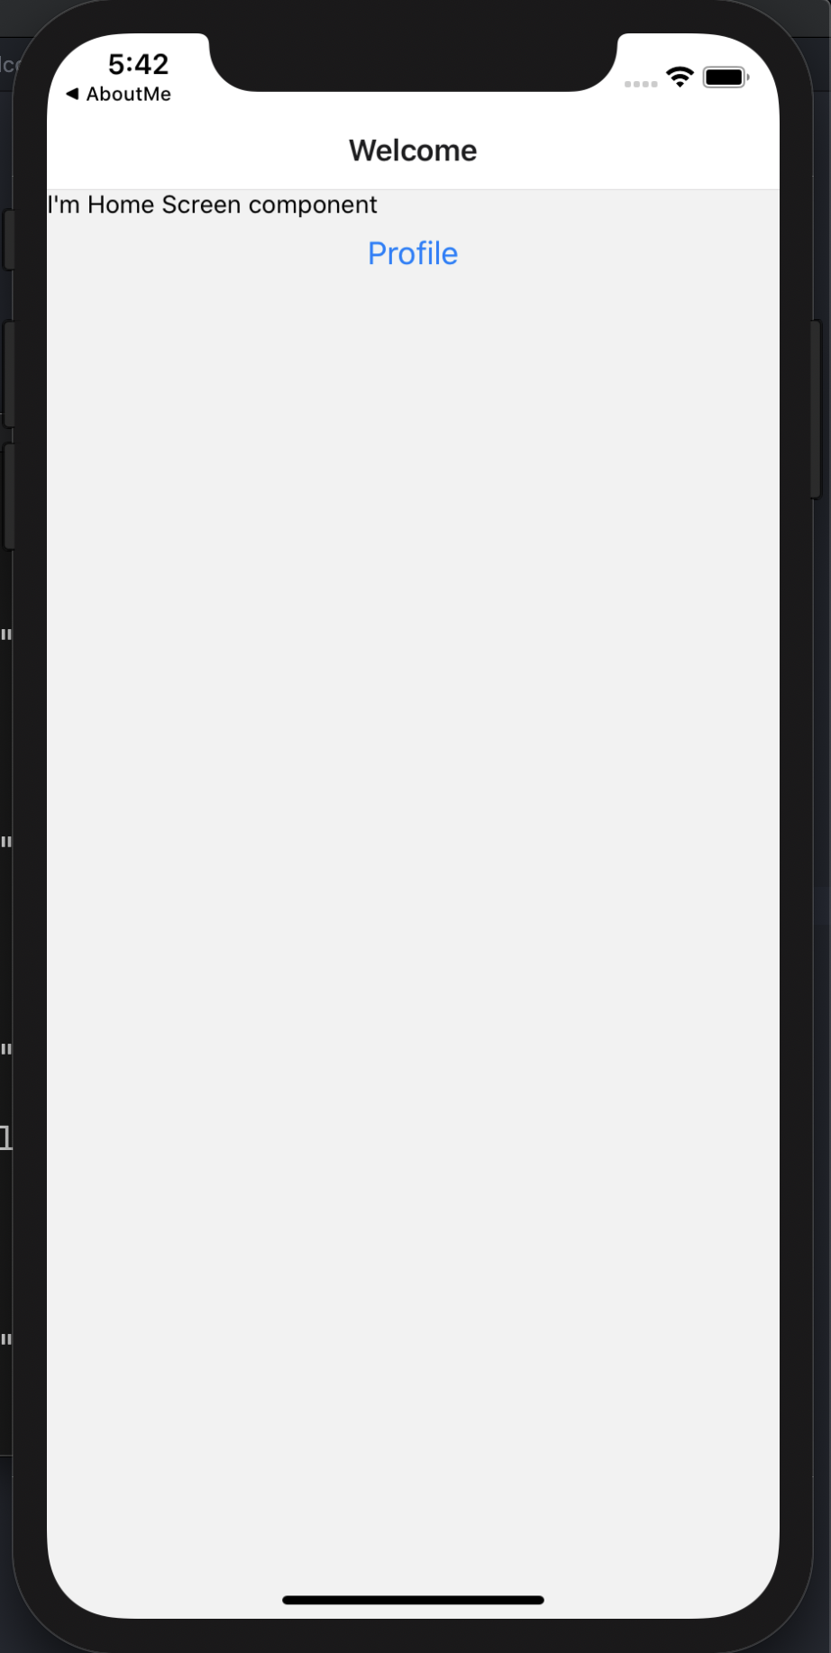
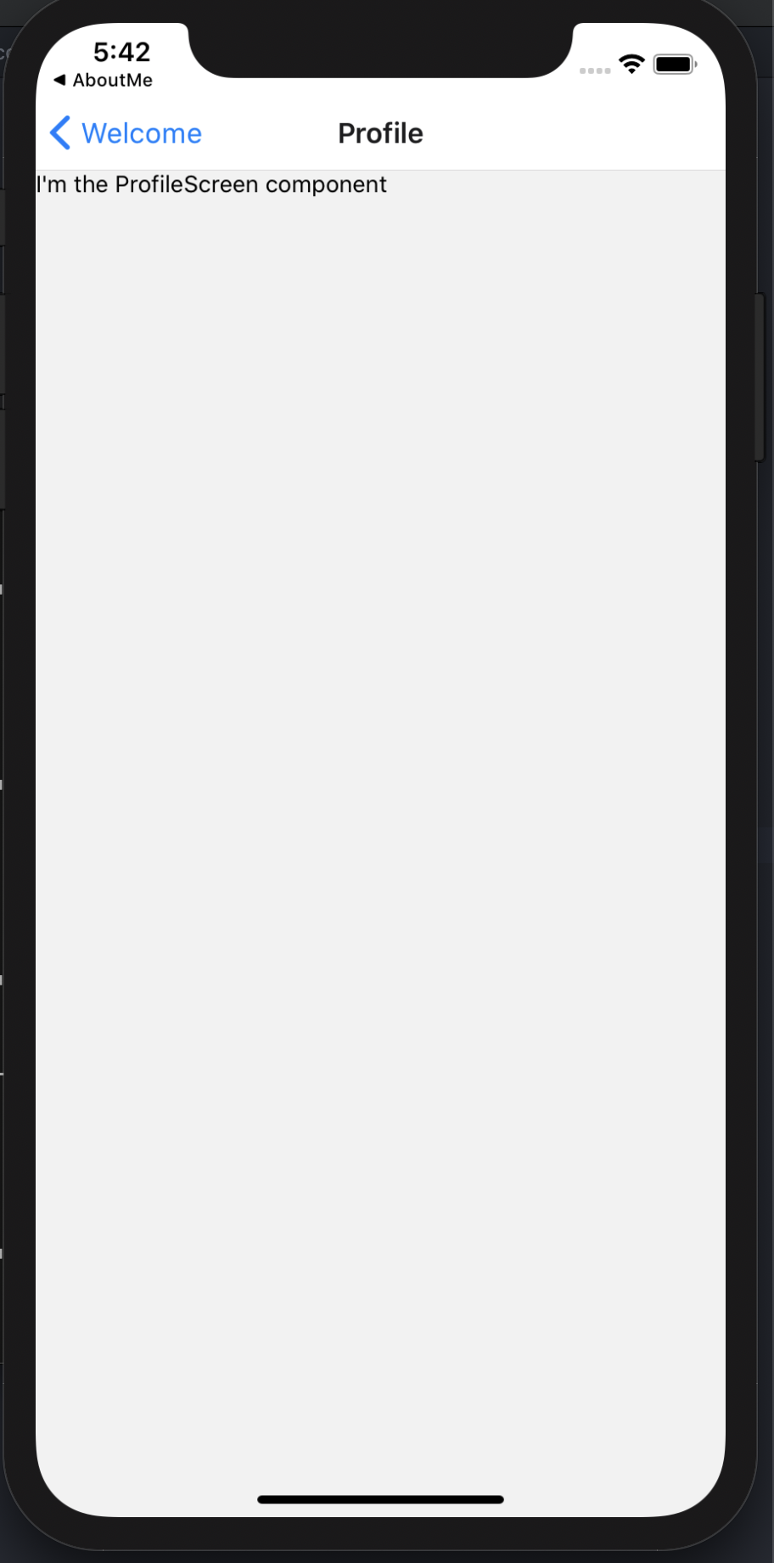
iOS

Slide 16
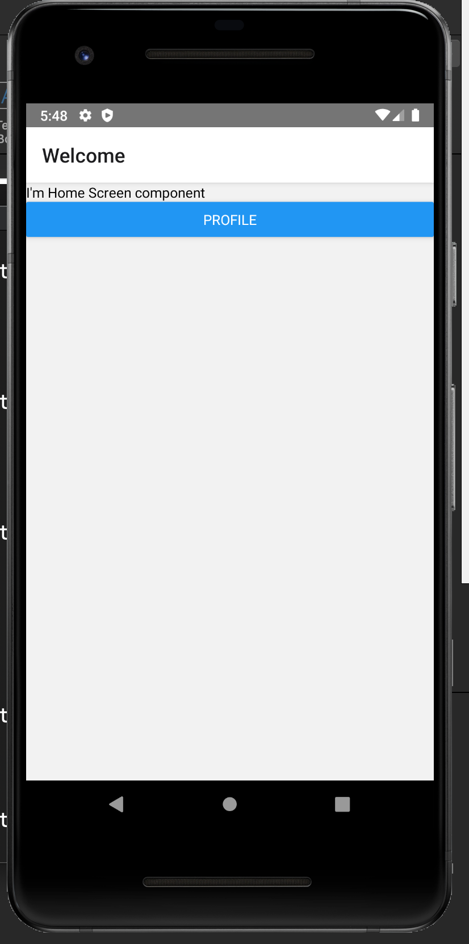
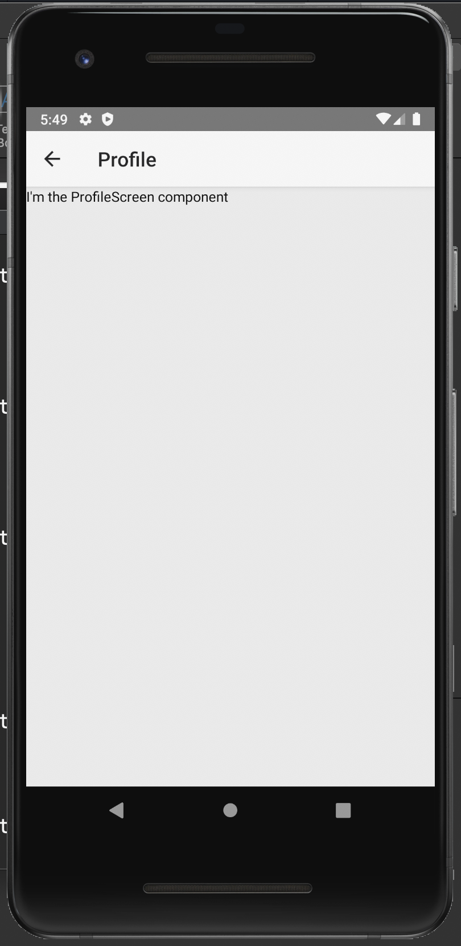
Android
Notes:
Note that the actual native components are used in the application
Also transitions are animated according to platform guidelines
For more information about customization of the navigation library check the documentation https://reactnavigation.org/docs/getting-started/

Slide 17
Navigation – what else can we do?
Basic approach can be done through component state and is based on if statements
It can be used for simple apps with limited number of screens (2-3). Anything more would lead to very unreadable code
Manual implementation of Back button is required
More complex apps should use library react-navigation documented here https://reactnative.dev/docs/navigation
This approach is more complex but allows for two things:
Handling multiple screens
Usage of native navigation elements
Notes:
We started with basic approach to navigation. Now we want to dive deeper into the navigation structure. Our previous navigation structure was quite flat and UI was based on Buttons (or other button-like components, for used looking like a button). This week we will see how we can build more modern navigation (menus, drawers etc) and more complex navigation structure. We will also discuss how we should structure the navigation and traps that we should avoid.
We can reuse this example to remind the students about the navigation we discussed in week 6
https://snack.expo.io/@ppawluk/week6-2 shows Basic navigation with Back button

Slide 18
Navigation – Stack
In a web browser, you can link to different pages using an anchor (<a>) tag. When the user clicks on a link, the URL is pushed to the browser history stack.
When the user presses the back button, the browser pops the item from the top of the history stack, so the active page is now the previously visited page.
React Native doesn't have a built-in idea of a global history stack like a web browser does
React Navigation's stack navigator provides a way for your app to transition between screens and manage navigation history.

Slide 19
Navigation – Stack
If your app uses only one stack navigator then it is conceptually similar to how a web browser handles navigation state - your app pushes and pops items from the navigation stack as users interact with it, and this results in the user seeing different screens.
A key difference between how this works in a web browser and in React Navigation is that React Navigation's stack navigator provides the gestures and animations that you would expect on Android and iOS when navigating between routes in the stack.

Slide 20
Navigation – Stack
The libraries we've installed so far are the building blocks and shared foundations for navigators, and each navigator in React Navigation lives in its own library.
To use the stack navigator, we need to install @react-navigation/stack
npm install @react-navigation/stack

Slide 21
Navigation – Stack
Two imports have to be added to the file
And the Stack object has to be created using the function createStackNavigator()
import { NavigationContainer } from '@react-navigation/native';
import { createStackNavigator } from '@react-navigation/stack’;
const Stack = createStackNavigator();

Slide 22
Navigation – Stack
Now, our main entry point to the application is not the main component but the navigator that refers to screens of the application
One of those screens will be our Home or Main screen
<NavigationContainer>
<Stack.Navigator>
<Stack.Screen name="Home" component={HomeScreen} />
<Stack.Screen name="Details" component={DetailsScreen} />
</Stack.Navigator>
</NavigationContainer>

Slide 23
Navigation – Stack
The Stack.Screen declarations are processed in order. In this case it means that the first one declared will be Home screen (no matter what the name is)
Each declaration has two attributes:
name of the route and
component that will implement the destination screen
Same component may be used multiple times for different routes, however it is not recommended

Slide 24
Navigation – Stack
You may be wondering if you can pass props to the component.
The answer is YES, you can do it is few different ways
Use React context and wrap the navigator with a context provider to pass data to the screens (recommended).
Use a render callback for the screen instead of specifying a component prop
<Stack.Screen name="Home">
{props => <HomeScreen {...props} extraData={someData} />}
</Stack.Screen>
Notes:
Note:
Spread syntax (...) allows an iterable such as an array expression or string to be expanded in places where zero or more arguments (for function calls) or elements (for array literals) are expected, or an object expression to be expanded in places where zero or more key-value pairs (for object literals) are expected.

Slide 25
Navigation – Stack – navigate
The component receives props:
navigation - the navigation prop is passed in to every screen component in stack navigator
route - this prop will be passed into all screens. Contains information about current route i.e. params, key and name.
Navigate allows you to perform transition once. It means that you will not be able to go to Details screen if you are already on it.
If you want to navigate to the same route multiple times, use push function.
Notes:
Note:
Spread syntax (...) allows an iterable such as an array expression or string to be expanded in places where zero or more arguments (for function calls) or elements (for array literals) are expected, or an object expression to be expanded in places where zero or more key-value pairs (for object literals) are expected.
Note:
Multiple navigates to the same screen should be only used if there is obvious purpose. It builds stack and may be confusing for users.
Sample: https://snack.expo.io/@ppawluk/week10-1

Slide 26
Navigation – Stack – back
The header provided by stack navigator will automatically include a back button when it is possible to go back from the active screen (if there is only one screen in the navigation stack, there is nothing that you can go back to, and so there is no back button).
Sometimes you'll want to be able to programmatically trigger this behavior, and for that you can use navigation.goBack();.
Notes:
Note:
Spread syntax (...) allows an iterable such as an array expression or string to be expanded in places where zero or more arguments (for function calls) or elements (for array literals) are expected, or an object expression to be expanded in places where zero or more key-value pairs (for object literals) are expected.
Note:
Multiple navigates to the same screen should be only used if there is obvious purpose. It builds stack and may be confusing for users.
Sample: https://snack.expo.io/@ppawluk/week10-1

Slide 27
Navigation – Stack – multi-back
Another common requirement is to be able to go back multiple screens
For example, if you are several screens deep in a stack and want to dismiss all of them to go back to the first screen. In this case, we know that we want to go back to Home so we can use navigate('Home') (not push! try that out and see the difference).
Another alternative would be navigation.popToTop(), which goes back to the first screen in the stack.
Notes:
Sample: https://snack.expo.io/@ppawluk/week10-2?platform=android&name=Hello%20React%20Navigation%20%7C%20React%20Navigation&dependencies=%40react-native-community%2Fmasked-view%40%5E0.1.7%2C%40react-navigation%2Fbottom-tabs%40%5E5.7.0%2C%40react-navigation%2Fdrawer%40%5E5.8.5%2C%40react-navigation%2Fmaterial-bottom-tabs%40%5E5.2.13%2C%40react-navigation%2Fmaterial-top-tabs%40%5E5.2.13%2C%40react-navigation%2Fnative%40%5E5.7.0%2C%40react-navigation%2Fstack%40%5E5.7.0%2Creact-native-paper%40%5E3.10.1%2Creact-native-reanimated%40%5E1.7.0%2Creact-native-safe-area-context%40%5E3.0.2%2Creact-native-screens%40%5E2.9.0%2Creact-native-tab-view%40%5E2.14.0&sourceUrl=https%3A%2F%2Freactnavigation.org%2Fexamples%2F5.x%2Fpop-to-top.js

Slide 28
Navigation – Stack – passing params to routes
Now that we know how to create a stack navigator with some routes and navigate between those routes, let's look at how we can pass data to routes when we navigate to them.
There are two pieces to this:
Pass params to a route by putting them in an object as a second parameter to the navigation.navigate function: navigation.navigate('RouteName', { /* params go here */ })
Read the params in your screen component: route.params.
Notes:
Note: You can also pass some initial params to a screen. If you didn't specify any params when navigating to this screen, the initial params will be used. They are also shallow merged with any params that you pass. Initial params can be specified with an initialParams prop

Slide 29
Navigation – Stack – passing params back
Params aren't only useful for passing some data to a new screen, but they can also be useful to pass data to a previous screen too. For example, let's say you have a screen with a create post button, and the create post button opens a new screen to create a post. After creating the post, you want to pass the data for the post back to previous screen.
To achieve this, you can use the navigate method, which acts like goBack if the screen already exists. You can pass the params with navigate to pass the data back
navigation.navigate('Home', { post: postText });
Notes:
Sample: https://snack.expo.io/@ppawluk/week10-4
Note: Note the questionmark ‘?’ in the following expression: route.params?.post
Params are resolved from an optional (it may be empty). If it is empty the post is not attempted.

Slide 30
Navigation – Stack – Options
In order to use params in the title, we need to make options prop for the screen a function that returns a configuration object.
It might be tempting to try to use this.props inside of options, but because it is defined before the component is rendered, this does not refer to an instance of the component and therefore no props are available.
Instead, if we make options a function then React Navigation will call it with an object containing { navigation, route } - in this case, all we care about is route, which is the same object that is passed to your screen props as route prop.
It's often necessary to update the options configuration for the active screen from the mounted screen component itself. We can do this using navigation.setOptions
Notes:
Code sample:
<Stack.Screen
name="Home"
component={HomeScreen}
options={{ title: 'My home' }}
/>

Slide 31
Navigation – Stack – Options
There are three key properties to use when customizing the style of your header: headerStyle, headerTintColor, and headerTitleStyle.
headerStyle: a style object that will be applied to the View that wraps the header. If you set backgroundColor on it, that will be the color of your header.
headerTintColor: the back button and title both use this property as their color. In the example below, we set the tint color to white (#fff) so the back button and the header title would be white.
headerTitleStyle: if we want to customize the fontFamily, fontWeight and other Text style properties for the title, we can use this to do it.
If you want to share the style you can instead move the configuration up to the stack navigator under the prop screenOptions.
Notes:
https://snack.expo.io/@ppawluk/week10-5
Sample to the last point: https://snack.expo.io/@ppawluk/week10-6

Slide 32
Navigation – Stack – Modals
A modal displays content that temporarily blocks interactions with the main view.
A modal is like a popup — it's not part of your primary navigation flow — it usually has a different transition, a different way to dismiss it, and is intended to focus on one particular piece of content or interaction.
The purpose of explaining this as part of the React Navigation fundamentals is not only because this is a common use case, but also because the implementation requires knowledge of nesting navigators, which is an important part of React Navigation.
Notes:
https://snack.expo.io/@ppawluk/week10-7
In this example we have two navigators (RootStack and MainStack)
We are using our MainStackScreen component as a screen inside RootStackScreen! By doing this, we are nesting a stack navigator inside of another stack navigator. In this case, this is useful for us because we want to use a different transition style for the modal. Since RootStackScreen renders a stack navigator and has its own header, we also want to hide the header for this screen. In the future this will be important because for tab navigation.
As you can see in the example, modal screen is a regular screen that is placed in the Navigator that has no header bar.

Slide 33
Navigation Structure
RootStack
MainStack
HomeScreen
DetailsScreen
ModalScreen
Notes:
Green elements are Navigators, blue are screens

Slide 34
Tab navigation
Possibly the most common style of navigation in mobile apps is tab-based navigation. This can be tabs on the bottom of the screen or on the top below the header (or even instead of a header).
You can use several styles of tab navigation that differ by placement (top or bottom) and style. The following functions can be used to add tabs to your application
createBottomTabNavigator.
createMaterialBottomTabNavigator
createMaterialTopTabNavigator .

Slide 35
Installation
We will use bottom tabs. To continue we have to install appropriate package
npm install @react-navigation/bottom-tabs

Slide 36
Tabs implementation
const Tab = createBottomTabNavigator();
export default function App() {
return (
<NavigationContainer>
<Tab.Navigator>
<Tab.Screen name="Home" component={A} />
<Tab.Screen name="Settings" component={B} />
</Tab.Navigator>
</NavigationContainer>
);
}
createBottomTabNavigator creates the navigator instance
Similarly to the Stack navigator, we add screens to the navigator.
These screens will be our tabs implemented by components A and B (example 8)
Each component can have own navigation structure (example 9)
Notes:
https://snack.expo.io/@ppawluk/week10-8
https://snack.expo.io/@ppawluk/week10-9

Slide 37
Drawer navigation
Common pattern in navigation is to use drawer from left (sometimes right) side for navigating between screens.
To use it, you have to install @react-navigation/drawer
npm install @react-navigation/drawer

Slide 38
Drawer navigation – usage
const Drawer = createDrawerNavigator();
export default function App() {
return (
<NavigationContainer>
<Drawer.Navigator initialRouteName="Home">
<Drawer.Screen name="Home" component={HomeScreen} />
<Drawer.Screen name="Notifications"
component={NotificationsScreen} />
</Drawer.Navigator>
</NavigationContainer>
);
}
Notes:
We use function createDrawerNavigator() to create navigator instance and add screens to it in JSX code.

Slide 39
Drawer navigation – usage
To open and close drawer, use the following helpers:
navigation.openDrawer();
navigation.closeDrawer();
If you would like to toggle the drawer you call the following:
navigation.toggleDrawer();
If you would like to determine if drawer is open or closed, you can do the following:
import { useIsDrawerOpen } from '@react-navigation/drawer';
// ...
const isDrawerOpen = useIsDrawerOpen();
Notes:
We use function createDrawerNavigator() to create navigator instance and add screens to it in JSX code.

Slide 40
Authentication flow
Most apps require that a user authenticate in some way to have access to data associated with a user or other private content. Typically the flow will look like this:
The user opens the app.
The app loads some authentication state from persistent storage (for example, AsyncStorage).
When the state has loaded, the user is presented with either authentication screens or the main app, depending on whether valid authentication state was loaded.
When the user signs out, we clear the authentication state and send them back to authentication screens.

Slide 41
Authentication flow
This is the behavior that we want from the authentication flow: when users sign in, we want to throw away the state of the authentication flow and unmount all of the screens related to authentication, and when we press the hardware back button we expect to not be able to go back to the authentication flow.
We can define different screens based on some condition. For example, if the user is signed in, we can define Home, Profile, Settings etc. If the user is not signed in, we can define SignIn and SignUp screens.

Slide 42
Authentication flow
isSignedIn ? (
<>
<Stack.Screen name="Home" component={HomeScreen} />
<Stack.Screen name="Profile" component={ProfileScreen} />
<Stack.Screen name="Settings" component={SettingsScreen} />
</>
) : (
<>
<Stack.Screen name="SignIn" component={SignInScreen} />
<Stack.Screen name="SignUp" component={SignUpScreen} />
</>
)
Notes:
When we define screens like this, when isSignedIn is true, React Navigation will only see the Home, Profile and Settings screens, and when it's false, React Navigation will see the SignIn and SignUp screens. This makes it impossible to navigate to the Home, Profile and Settings screens when the user is not signed in, and to SignIn and SignUp screens when the user is signed in.
This pattern has been in use by other routing libraries such as React Router for a long time, and is commonly known as "Protected routes". Here, our screens which need the user to be signed in are "protected" and cannot be navigated to by other means if the user is not signed in.
The magic happens when the value of the isSignedIn variable changes. Let's say, initially isSignedIn is false. This means, either SignIn or SignUp screens are shown. After the user signs in, the value of isSignedIn will change to true. React Navigation will see that the SignIn and SignUp screens are no longer defined and so it will remove them. Then it'll show the Home screen automatically because that's the first screen defined when isSignedIn is true.
It's important to note that when using such a setup, you don't need to navigate to the Home screen manually by calling navigation.navigate('Home'). React Navigation will automatically navigate to the Home screen when isSignedIn becomes true.
This takes advantage of a new feature in React Navigation: being able to dynamically define and alter the screen definitions of a navigator based on props or state. The example shows stack navigator, but you can use the same approach with any navigator.
By conditionally defining different screens based on a variable, we can implement auth flow in a simple way that doesn't require additional logic to make sure that the correct screen is shown.
You can see the flow in the example https://snack.expo.io/@ppawluk/week10-10

Slide 43
Preventing going back
Sometimes you may want to prevent the user from leaving a screen, for example, if there are unsaved changes, you might want to show a confirmation dialog.
You can achieve it by using the beforeRemove event. This event is triggered whenever a screen is being removed. For example:
The user pressed back button on a screen in a stack
The user performed a swipe back gesture
Some action such as pop or reset was dispatched which removes the screen from the state
The event receives the action that triggered it. You can dispatch this action again after confirmation, or check the action object to determine what to do.

Slide 44
Access to navigation without prop
useNavigation is a hook which gives access to the navigation object. It's useful when you cannot pass the navigation prop into the component directly, or don't want to pass it in case of a deeply nested child.
An ordinary component that is not a screen component will not receive the navigation prop automatically. (example of such component is a custom button component that needs navigation to perform action)
Don’t forget about import
import { useNavigation } from '@react-navigation/native'

Slide 45
Themes
Themes allow you to change the colors of various components provided by React Navigation. You can use themes to:
Customize the colors match your brand
Provide light and dark themes based on the time of the day or user preference

Slide 46
Themes
A theme is a JS object containing a list of colors to use. It contains the following properties:
dark (boolean): Whether this is a dark theme or a light theme
colors (object): Various colors used by react navigation components:
primary (string): The primary color of the app used to tint various elements. Usually you'll want to use your brand color for this.
background (string): The color of various backgrounds, such as background color for the screens.
card (string): The background color of card-like elements, such as headers, tab bars etc.
text (string): The text color of various elements.
border (string): The color of borders, e.g. header border, tab bar border etc.
notification (string): The color of Tab Navigator badge.

Slide 47
Built-in Theme
As operating systems add built-in support for light and dark modes, supporting dark mode is less about keeping hip to trends and more about conforming to the average user expectations for how apps should work.
In order to provide support for light and dark mode in a way that is reasonably consistent with the OS defaults, these themes are built in to React Navigation.
import { DefaultTheme, DarkTheme } from '@react-navigation/native';

Slide 48
State persistence
You might want to save the user's location in the app, so that they are immediately returned to the same location after the app is restarted.
This is especially valuable during development because it allows the developer to stay on the same screen when they refresh the app.
To be able to persist the navigation state, we can use the onStateChange and initialState props of the container.
onStateChange - This prop notifies us of any state changes. We can persist the state in this callback.
initialState - This prop allows us to pass an initial state to use for navigation state. We can pass the restored state in this prop.

Slide 49
Warning: Serializable State
Each param, route, and navigation state must be fully serializable for this feature to work. Typically, you would serialize the state as a JSON string. This means that your routes and params must contain no functions, class instances, or recursive data structures.
You can modify the initial state object before passing it to container, but note that if your initialState provides an invalid object (an object from which the navigation state cannot be recovered), React Navigation may not be able to handle the situation gracefully.

Slide 50
Summary
As a potential user of the library, it's important to know what you can and cannot do with it. Armed with this knowledge, you may choose to adopt a different library instead.
This pitch & anti-pitch section discusses high level design decisions and covers some of the use cases that are either not supported or are so difficult to do that they may as well be impossible. If any of the following limitations are deal breakers for your app, React Navigation might not be for you.
One of the largest stoppers may be lack of proper support for RTL layouts.

Slide 51
More about styles

Slide 52
Style
With React Native, you style your application using JavaScript not CSS.
All of the core components accept a prop named style.
The style names and values usually match how CSS works on the web, except names are written using camel casing, e.g. backgroundColor rather than background-color.
Like in CSS you can create stand-alone StyleSheet or apply styles individually to each component

Slide 53
Style
Style prop is either empty or defined as:
an object style={{width:50}}
a reference to a style defined in a stylesheet style={styles.container}
an array of objects that are either referneces to the stylesheet or objects
style={[styles.container, {width:100}]}

Slide 54
Example
In this example you can see that styles are applied in order (left to right) overriding the style elements that are redefined (color in this case).
You can also see that the style is inherited by nested Text component in a similar way it is inherited in CSS
Notes:
https://snack.expo.io/@ppawluk/week5-1

Slide 55
Control size
The general way to set the dimensions of a component is by adding a fixed width and height to style.
It works for elements that should always render at exactly the same size, regardless of screen dimensions.
All dimensions in React Native are unitless and represent density-independent pixels.
Notes:
https://snack.expo.io/@ppawluk/week5-2

Slide 56
Flex dimensions
Use flex in a component's style to have the component expand and shrink dynamically based on available space.
Use flex: 1 to tell a component to fill all available space, shared evenly amongst other components with the same parent.
Use other values as a weight. The larger the flex given, the higher the ratio of space a component will take compared to its siblings.
Notes:
https://snack.expo.io/@ppawluk/week5-2

Slide 57
Layout with flexbox
A component can specify the layout of its children using the Flexbox algorithm. Flexbox is designed to provide a consistent layout on different screen sizes.
You will use a combination of flexDirection, alignItems, and justifyContent to achieve the right layout.
Flexbox works the same way in React Native as it does in CSS on the web, with a few exceptions. The defaults are different, with flexDirection defaulting to column instead of row, and the flex parameter only supporting a single number.

Slide 58
Flex
We have used flex before, let’s see now how it exactly works
flex will define how your items are going to “fill” over the available space along your main axis. Space will be divided according to each element's flex property.
E.g. if you have 3 elements and set flex values to 3, 2 and 1 respectively, the system will calculate 3+2+1=6 and divide the space into 3/6, 2/6 and 1/6
Notes:
See example https://snack.expo.io/@ppawluk/week5-2

Slide 59
Flex direction
flexDirection controls the direction in which the children of a node are laid out. This is also referred to as the main axis. The cross axis is the axis perpendicular to the main axis, or the axis which the wrapping lines are laid out in.
column (default value) Align children from top to bottom. If wrapping is enabled, then the next line will start to the right of the first item on the top of the container.
row Align children from left to right. If wrapping is enabled, then the next line will start under the first item on the left of the container.
row-reverse Align children from right to left. If wrapping is enabled, then the next line will start under the first item on the right of the container.
column-reverse Align children from bottom to top. If wrapping is enabled, then the next line will start to the right of the first item on the bottom of the container.
Notes:
https://snack.expo.io/@ppawluk/week5-3

Slide 60
Justify content
justifyContent describes how to align children within the main axis of their container.
flex-start(default value) Align children of a container to the start of the container's main axis.
flex-end Align children of a container to the end of the container's main axis.
center Align children of a container in the center of the container's main axis.
space-between Evenly space off children across the container's main axis, distributing the remaining space between the children.
space-around Evenly space off children across the container's main axis, distributing the remaining space around the children. Compared to space-between, using space-around will result in space being distributed to the beginning of the first child and end of the last child.
space-evenly Evenly distribute children within the alignment container along the main axis. The spacing between each pair of adjacent items, the main-start edge and the first item, and the main-end edge and the last item, are all exactly the same.
Notes:
https://snack.expo.io/@ppawluk/week5-4

Slide 61
Align items
alignItems describes how to align children along the cross axis of their container. It is similar to justifyContent but instead of applying to the main axis, alignItems applies to the cross axis.
stretch (default value) Stretch children of a container to match the height of the container's cross axis.
flex-start Align children of a container to the start of the container's cross axis.
flex-end Align children of a container to the end of the container's cross axis.
center Align children of a container in the center of the container's cross axis.
baseline Align children of a container along a common baseline. Individual children can be set to be the reference baseline for their parents.
Notes:
https://snack.expo.io/@ppawluk/week5-5

Slide 62
Align self
alignSelf has the same options and effect as alignItems but instead of affecting the children within a container, you can apply this property to a single child to change its alignment within its parent.
alignSelf overrides any option set by the parent with alignItems.
Notes:
https://snack.expo.io/@ppawluk/week5-5

Slide 63
Align content
alignContent defines the distribution of lines along the cross-axis. This only has effect when items are wrapped to multiple lines using flexWrap.
flex-start (default value) Align wrapped lines to the start of the container's cross axis.
flex-end Align wrapped lines to the end of the container's cross axis.
stretch Stretch wrapped lines to match the height of the container's cross axis.
center Align wrapped lines in the center of the container's cross axis.
space-between Evenly space wrapped lines across the container's main axis, distributing the remaining space between the lines.
space-around Evenly space wrapped lines across the container's main axis, distributing the remaining space around the lines. Compared to space-between, using space-around will result in space being distributed to the beginning of the first line and the end of the last line.
Notes:
https://snack.expo.io/@ppawluk/week5-6

Slide 64
flexWrap
The flexWrap property is set on containers and it controls what happens when children overflow the size of the container along the main axis. By default, children are forced into a single line (which can shrink elements). If wrapping is allowed, items are wrapped into multiple lines along the main axis if needed.
Notes:
https://snack.expo.io/@ppawluk/week5-6

Slide 65
Flex Basis, Grow, and Shrink
flexGrow describes how any space within a container should be distributed among its children along the main axis. Accepts floating point value >= 0, 0 is default
flexShrink describes how to shrink children along the main axis in the case in which the total size of the children overflows the size of the container on the main axis. Accepts floating point value >= 0, 0 is default
flexBasis is an axis-independent way of providing the default size of an item along the main axis. It is like setting width or height but on top flexGrow and flexShring calculations are applied
Notes:
https://snack.expo.io/@ppawluk/week5-7

Slide 66
Absolute & Relative Layout
The position type of an element defines how it is positioned within its parent.
relative (default value) By default, an element is positioned relatively. i.e. positioned according to the normal flow of the layout, and then offset relative to that position based on the values of top, right, bottom, and left.
absolute When positioned absolutely, an element doesn't take part in the normal layout flow. It is instead laid out independent of its siblings. The position is determined based on the top, right, bottom, and left values.
Notes:
https://snack.expo.io/@ppawluk/week5-8

Slide 67
Other props
Layout: https://reactnative.dev/docs/layout-props
View: https://reactnative.dev/docs/view-style-props
Text: https://reactnative.dev/docs/text-style-props
Image: https://reactnative.dev/docs/image-style-props
Shadow: https://reactnative.dev/docs/shadow-props

Slide 68
Organization of Style Sheets
React Native focuses on the component. The goal is to make components as reusable and standalone as possible. Having a component dependent upon an application’s stylesheet is the antithesis of modularity.
In React Native, styles are scoped to the component – not to the application.
Approaches to organization:
declaring stylesheets within the same file as the component
declaring stylesheets in a separate file, outside of the component.
Notes:
When styling web sites, we use stylesheets all the time. Quite often we use tools like Sass, Less, and PostCSS to create monolithic stylesheets for our entire application. In the world of the web, our styles are global, but that isn’t the React Native way.
How to accomplish this encapsulation depends entirely upon your team’s preference. No right or wrong way exists, but in the React Native community, you’ll find two common approaches

Slide 69
Style Sheet in the same file
A popular way to declare styles is within the component that uses them. The major benefit of this is that the component and its styles are completely encapsulated within a single file.
This component can then be moved or used anywhere in the app. This is a common approach to component design, one that you see often within the React (Native) community.
When including the stylesheet definitions with the component, the typical convention is to specify the styles after the component.

Slide 70
Separating the Style Sheet
YourProject
C1
C1Implementation.js
C1StyleSheet.js
C2
C2Implementation.js
C2StyleSheet.js
You may be tempted to do it if you did CSS in web development.
The stylesheet definitions are created in a separate file. You can name it whatever you want, as long as it has .js extension (styles.js is typical)
The stylesheet file and component file are saved in the same folder.
Notes:
When styling web sites, we use stylesheets all the time. Quite often we use tools like Sass, Less, and PostCSS to create monolithic stylesheets for our entire application. In the world of the web, our styles are global, but that isn’t the React Native way.
How to accomplish this encapsulation depends entirely upon your team’s preference. No right or wrong way exists, but in the React Native community, you’ll find two common approaches

Slide 71
Separating the Style Sheet
When you decide to separate the style sheets from the implementation, you have to export all style sheets created in the file and import them where needed
You can define multiple stylesheets in a single file
Each stylesheet can have multiple style objects defined in it
You can have multiple files with styles for a single component, but it looks quite excessive
Notes:
In this example you have to check 2 files App.js and styles.js
https://snack.expo.io/@ppawluk/week5-9

Slide 72
Reusing styles
The problem in React-native is that we wat to achieve encapsulation of components (independence)
Using common stylesheet would break that independence
What we can actually do instead, we can separate some common constants and use them to specify the styles
export const COLOR_PRIMARY = '#58C9B9'; export const COLOR_SECONDARY = '#111'; export const FONT_NORMAL = 'OpenSans-Regular'; export const FONT_BOLD = 'OpenSans-Bold'; export const BORDER_RADIUS = 5;
Notes:
https://snack.expo.io/@ppawluk/week5-10
In this project background colors are used as constants

Slide 73
Using dynamic styles
Let’s take advantage of the fact that we’re using JavaScript and start thinking of our styles as code. Let’s build an application that gives the user a button to change the theme from light to dark.
The application has a single button on the screen. That button is enclosed by a small square box. When the button is pressed, the themes toggle. When the light theme is selected, the button label says WHITE, the background is white, and the box around the button is black.
Notes:
https://snack.expo.io/@ppawluk/week5-10
Numbers refer to the comments in the example
❶ Import the getStyleSheet function from our externalized styles
❷ Initialize our component’s state to show the light theme by default.
❸ Bind the toggleTheme function to the component. Without binding the function to the component, this is undefined, and you’ll get exceptions when trying to run the code.
❹ Toggle the theme value in state whenever the function’s called.
❺ Use our imported getStyleSheet function to get the appropriate stylesheet for whatever theme should be displayed.
❻ React Native provides the StyleSheet.flatten utility function to convert the StyleSheet object into a simple JavaScript object. Doing this transformation makes It much easier to get the backgroundColor being used.
❼ Reference our theme’s container style
❽ Reference our theme’s box style (the box border around the button)
❾ A string representation of the color being used by the theme
❿ When the button’s pressed, call the toggleTheme function to alternate from one theme to another.

